Slide 1

AG News Topic Classification
CSML 1010 - Winter 2020 - Group 20
Tony Lee, Viswesh Krishnamurthy

Slide 2
PROBLEM SELECTION & DEFINITION
A text classification problem was chosen from the website https://datasets.quantumstat.com/. We chose the AG News corpus dataset
The goal of this project is to develop a text classifier model that can accept a news ‘headline’ and ‘content’ of the news to classify the news article into one of the 4 following categories
World (coded as 1)
Sports (2)
Business (3)
Sci/Tech (4)

Slide 3
BACKGROUND OF THE DATASET
AG is a collection of more than 1 million news articles. News articles have been gathered from more than 2000 news sources by ComeToMyHead in more than 1 year of activity. ComeToMyHead is an academic news search engine which has been running since July, 2004. The dataset is provided by the academic community for research purposes in data mining (clustering, classification, etc), information retrieval (ranking, search, etc), xml, data compression, data streaming, and any other non-commercial activity. For more information, please refer to the link http://www.di.unipi.it/~gulli/AG_corpus_of_news_articles.html
The AG's news topic classification dataset is constructed by Xiang Zhang (xiang.zhang@nyu.edu) from the dataset above. It is used as a text classification benchmark in the following paper: Xiang Zhang, Junbo Zhao, Yann LeCun. Character-level Convolutional Networks for Text Classification. Advances in Neural Information Processing Systems 28 (NIPS 2015).

Slide 4
FEATURE ENGINEERING & MODELS - PLAN
We will perform feature engineering using the following methods
Bag of words
Bag of n-grams
Tfidf
Glove
We will use the following models to perform classification
Logistic regression
Decision trees
SVM
Naive Bayes

Slide 5
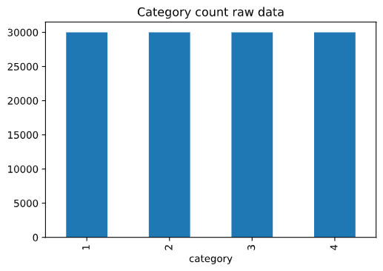
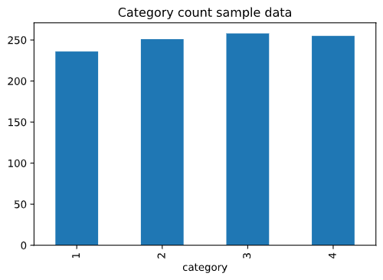
DATA CLEANING
The raw data was explored to identify whether it required balancing. It was found that there were equal number of ‘headlines’ and ‘content’ for each category. (Each category has 30,000)
We started with a sample of 1000 rows from the raw data. The sample data was pretty balanced as well

Slide 6
DATA CLEANING
Header: The raw data did not contain headers for the columns. The columns were appropriately named
HTML Code: There were some HTML code found in the raw data, like “&gt” and “&lt” and were removed
News Sources: Some of the rows in the ‘headline’ column contained the news source like (Reuters), (AP) etc. These were removed as they don’t contribute much to the overall classification problem
train_data.columns = ['category', 'headline', 'content']
import re
def clean(x):
x = re.sub(r'(&[A-Za-z]+)|\(.*\)', '', x)
return str(x)
for i, row in train_data_sample.iterrows():
train_data_sample.at[i, "headline"] = clean(row.headline)

Slide 7
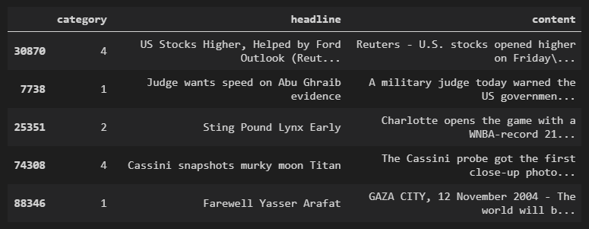
DATA EXPLORATION
We will take a look at the top few rows of the dataset
train_data_sample.head()

Slide 8
DATA EXPLORATION
To better understand the data, we built a “Countvectorizer” with a minimum document frequency of 2 and included regex commands to discard numbers, symbols & special characters.
For now, we chose to build a ‘unigram’
We produced a bag of words dataframe, cv_matrix_df
# create a CountVectorizer from raw data, with options to clean it
cv = CountVectorizer(min_df = 2, lowercase = True, token_pattern=r'(?u)\b[A-Za-z]{2,}\b',
strip_accents = 'ascii', ngram_range = (1, 1),
stop_words = 'english')
cv_matrix = cv.fit_transform(train_data_sample.headline).toarray()
# get all unique words in the corpus
vocab = cv.get_feature_names()
# produce a dataframe including the feature names
cv_matrix_df = pandas.DataFrame(cv_matrix, columns=vocab)

Slide 9
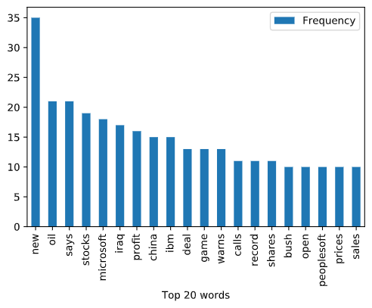
DATA EXPLORATION
Further manipulating the data, we produced a bar chart of the Top-20 most common words of the headlines of the news articles
Top 20 most common words

Slide 10
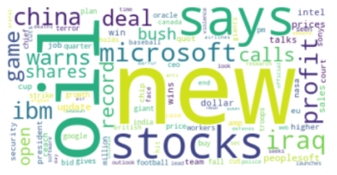
DATA EXPLORATION
We also produced a word cloud of the headlines

Slide 11
This marks the initial proposal stage of the project. As we progress, we will iterate through the ML lifecycle and the feature engineering and data exploration steps may accordingly change

Slide 12
PROJECT MILESTONE 1 – 18th Apr 2020

Slide 13
FEATURE ENGINEERING & MODELS - PLAN
We have performed feature engineering using the following methods
Bag of words, Bag of n-grams, Bag of characters
Tf/Idf, Tf/Idf Unigrams, Tf/Idf N-grams, Tf/Idf Characters
Word2Vec
We built the first model with SVM with a sample data of 4000 rows
We will continue to build more models as seen below,
Naive Bayes
Logistic Regression
Decision Trees
GBM (Gradient Boosting)

Slide 14
FEATURE ENGINEERING – BAG OF WORDS
# Use countvectorizer to get a vector of words
cv = CountVectorizer(min_df = 2, lowercase = True,
token_pattern=r'\b[A-Za-z]{2,}\b', ngram_range = (1, 1))
x_train_cv = cv.fit_transform(x_train.content_cleaned).toarray()
x_test_cv = cv.transform(x_test.content_cleaned).toarray()
# get all unique words in the corpus
bow_vocab = cv.get_feature_names()
# produce a dataframe including the feature names
x_train_bagofwords = pandas.DataFrame(x_train_cv, columns=bow_vocab)
x_test_bagofwords = pandas.DataFrame(x_test_cv, columns=bow_vocab)
x_train_bagofwords.head()

Slide 15
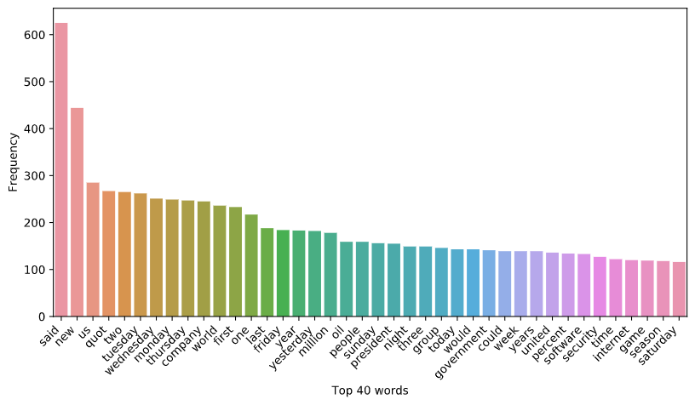
FEATURE ENGINEERING – BAG OF WORDS (Cont’d)

Slide 16
FEATURE ENGINEERING – BAG OF N-GRAMS
# Use countvectorizer to get a vector of n-grams
cv = CountVectorizer(min_df = 2, lowercase = True,
token_pattern=r'\b[A-Za-z]{2,}\b', ngram_range = (2, 3))
x_train_cv = cv.fit_transform(x_train).toarray()
x_test_cv = cv.transform(x_test).toarray()
# get all unique words in the corpus
ngram_vocab = cv.get_feature_names()
# produce a dataframe including the feature names
x_train_bagofngrams = pandas.DataFrame(x_train_cv, columns=ngram_vocab)
x_test_bagofngrams = pandas.DataFrame(x_test_cv, columns=ngram_vocab)
x_train_bagofngrams.head()

Slide 17
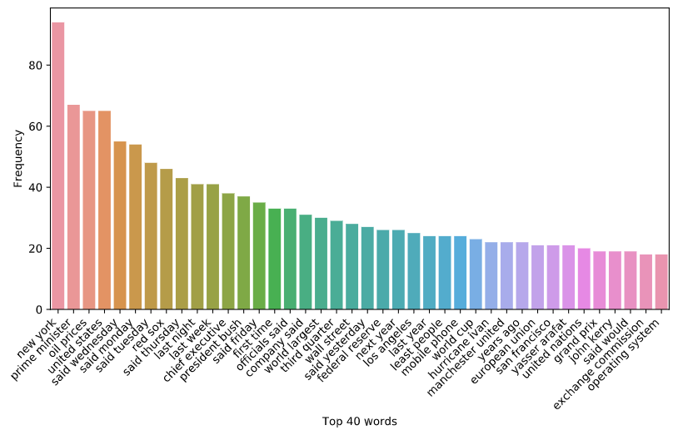
FEATURE ENGINEERING – BAG OF N-GRAMS (Cont’d)

Slide 18
FEATURE ENGINEERING – BAG OF CHARS
# Use countvectorizer to get a vector of chars
cv = CountVectorizer(analyzer='char', min_df = 2, ngram_range = (2, 3),
token_pattern=r'\b[A-Za-z]{2,}\b')
x_train_cv = cv.fit_transform(x_train).toarray()
x_test_cv = cv.transform(x_test).toarray()
# get all unique words in the corpus
cv_char_vocab = cv.get_feature_names()
# produce a dataframe including the feature names
x_train_cv_char = pandas.DataFrame(x_train_cv, columns = cv_char_vocab)
x_test_cv_char = pandas.DataFrame(x_test_cv, columns=cv_char_vocab)
x_train_cv_char.head()

Slide 19
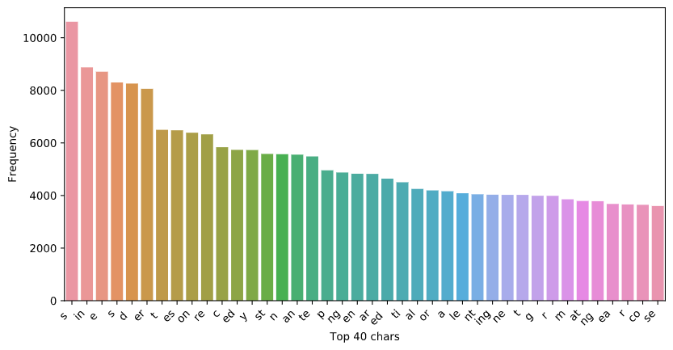
FEATURE ENGINEERING – BAG OF CHARS (Cont’d)

Slide 20
FEATURE ENGINEERING – TF/IDF UNIGRAMS
# Use TF/IDF vectorizer to get a vector of unigrams
tfidf_vect = TfidfVectorizer(sublinear_tf = True, min_df = 2, ngram_range = (1, 1),
use_idf = True, token_pattern=r'\b[A-Za-z]{2,}\b')
x_train_tfidf_unigram = tfidf_vect.fit_transform(x_train).toarray()
x_test_tfidf_unigram = tfidf_vect.transform(x_test).toarray()
# get all unique words in the corpus
vocab = tfidf_vect.get_feature_names()
# produce a dataframe including the feature names
x_train_tfidf_unigram = pandas.DataFrame(numpy.round(x_train_tfidf_unigram, 2), columns = vocab)
x_test_tfidf_unigram = pandas.DataFrame(numpy.round(x_test_tfidf_unigram, 2), columns = vocab)
x_train_tfidf_unigram.head()

Slide 21
FEATURE ENGINEERING – TF/IDF N-GRAMS
# Use TF/IDF vectorizer to get a vector of n-grams
tfidf_vect = TfidfVectorizer(sublinear_tf = True, min_df = 2, ngram_range = (2, 3),
use_idf = True, token_pattern=r'\b[A-Za-z]{2,}\b')
x_train_tfidf_ngram = tfidf_vect.fit_transform(x_train).toarray()
x_test_tfidf_ngram = tfidf_vect.fit_transform(x_test).toarray()
# get all unique words in the corpus
vocab = tfidf_vect.get_feature_names()
# produce a dataframe including the feature names
x_train_tfidf_ngram = pandas.DataFrame(numpy.round(x_train_tfidf_ngram, 2), columns = vocab)
x_test_tfidf_ngram = pandas.DataFrame(numpy.round(x_test_tfidf_ngram, 2), columns = vocab)
x_train_tfidf_ngram.head()

Slide 22
FEATURE ENGINEERING – TF/IDF CHARS
# Use TF/IDF vectorizer to get a vector of chars
tfidf_vect = TfidfVectorizer(analyzer = 'char', sublinear_tf = True, min_df = 2,
ngram_range = (2, 3), use_idf = True,
token_pattern=r'\b[A-Za-z]{2,}\b')
x_train_tfidf_char = tfidf_vect.fit_transform(x_train).toarray()
x_test_tfidf_char = tfidf_vect.transform(x_test).toarray()
# get all unique words in the corpus
char_vocab = tfidf_vect.get_feature_names()
# produce a dataframe including the feature names
x_train_tfidf_char = pandas.DataFrame(numpy.round(x_train_tfidf_char, 2), columns = char_vocab)
x_test_tfidf_char = pandas.DataFrame(numpy.round(x_test_tfidf_char, 2), columns = char_vocab)
x_train_tfidf_char.head()

Slide 23
FEATURE ENGINEERING – WORD2VEC
# ## Using gensim to build Word2Vec
from gensim.models import word2vec
# tokenize sentences in corpus
wpt = nltk.WordPunctTokenizer()
tokenized_corpus = [wpt.tokenize(document) for document in x_train]
# Set values for various parameters
feature_size = 100 # Word vector dimensionality
window_context = 20 # Context window size
workers = 10
min_word_count = 5 # Minimum word count
sample = 1e-3 # Downsample setting for frequent words
w2v_model = word2vec.Word2Vec(tokenized_corpus, size=feature_size,
window=window_context, min_count=min_word_count,
sample=sample, iter=500)

Slide 24
FEATURE ENGINEERING – WORD2VEC (Cont’d)
# ### Visualize Word Embedding
# %%
from sklearn.manifold import TSNE
words = w2v_model.wv.index2word
wvs = w2v_model.wv[words]
tsne = TSNE(n_components=2, random_state=0, n_iter=500, perplexity=2)
numpy.set_printoptions(suppress=True)
T = tsne.fit_transform(wvs)
labels = words
plt.figure(figsize=(12, 6))
plt.scatter(T[:, 0], T[:, 1], c='orange', edgecolors='r')
for label, x, y in zip(labels, T[:, 0], T[:, 1]):
plt.annotate(label, xy=(x+1, y+1), xytext=(0, 0), textcoords='offset points')

Slide 25
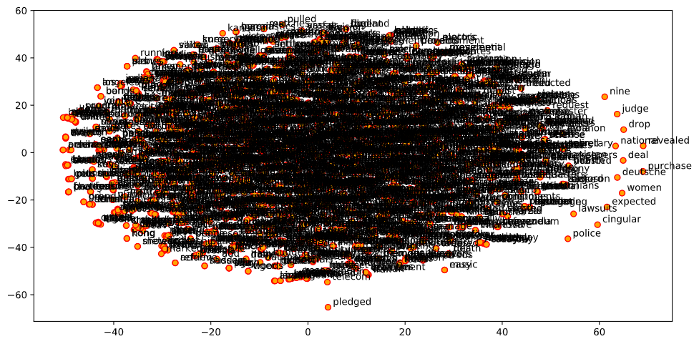
FEATURE ENGINEERING – WORD2VEC (Cont’d)

Slide 26
FEATURE ENGINEERING – WORD2VEC (Cont’d)
# ### Functions to get document level embeddings
def average_word_vectors(words, model, vocabulary, num_features):
feature_vector = numpy.zeros((num_features,),dtype="float64")
nwords = 0.
for word in words:
if word in vocabulary:
nwords = nwords + 1.
feature_vector = numpy.add(feature_vector, model[word])
if nwords:
feature_vector = numpy.divide(feature_vector, nwords)
return feature_vector
def averaged_word_vectorizer(corpus, model, num_features):
vocabulary = set(model.wv.index2word)
features = [average_word_vectors(tokenized_sentence, model, vocabulary, num_features)
for tokenized_sentence in corpus]
return numpy.array(features)

Slide 27
FEATURE ENGINEERING – WORD2VEC (Cont’d)
# ### Obtain document level embeddings
w2v_feature_array = averaged_word_vectorizer(corpus=tokenized_corpus, model=w2v_model,
num_features=feature_size)
pandas.DataFrame(w2v_feature_array)
word_freq_df = pandas.DataFrame(x_train_bagofwords.toarray(), columns=cv.get_feature_names())
top_words_df = pandas.DataFrame(word_freq_df.sum()).sort_values(0, ascending=False)
word_freq_df.head(20)
top_words_df.head(20)

Slide 28
MODELLING - SVM
# Run classifier
classifier = OneVsRestClassifier(svm.LinearSVC(random_state=1))
classifier.fit(x_train_bagofwords, y_train)
y_score = classifier.decision_function(x_test_bagofwords)
# The average precision score in multi-label settings
# For each class
precision = dict()
recall = dict()
average_precision = dict()
for i in range(n_classes):
precision[i], recall[i], _ = precision_recall_curve(y_test[:, i], y_score[:, i])
average_precision[i] = average_precision_score(y_test[:, i], y_score[:, i])
# A "micro-average": quantifying score on all classes jointly
precision["micro"], recall["micro"], _ = precision_recall_curve(y_test.ravel(), y_score.ravel())
average_precision["micro"] = average_precision_score(y_test, y_score, average="micro")
print('Average precision score, micro-averaged over all classes: {0:0.2f}'
.format(average_precision["micro"]))

Slide 29
MODELLING – SVM (Cont’d)
# Plot the micro-averaged Precision-Recall curve
plt.figure()
plt.step(recall['micro'], precision['micro'], where='post')
plt.xlabel('Recall')
plt.ylabel('Precision')
plt.ylim([0.0, 1.05])
plt.xlim([0.0, 1.0])
plt.title(
'Average precision score, micro-averaged over all classes: AP={0:0.2f}'
.format(average_precision["micro"]))

Slide 30
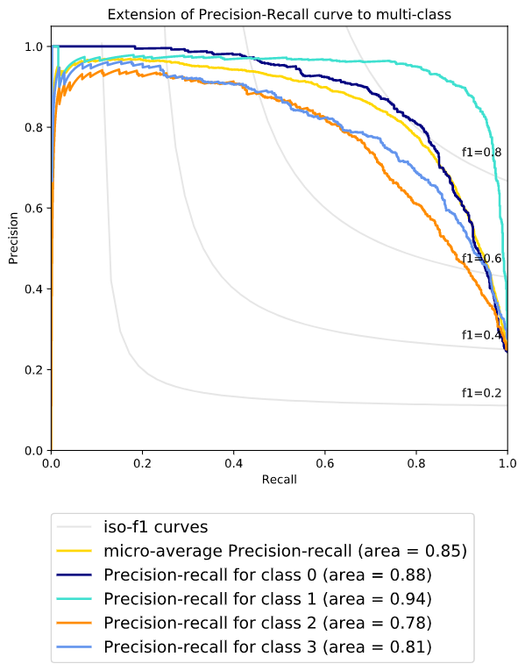
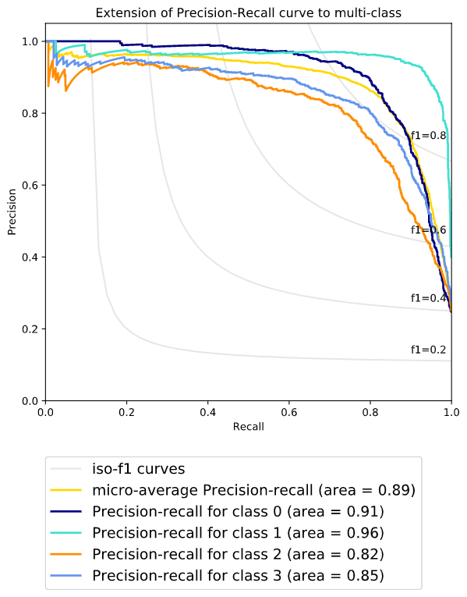
SVM MODEL RESULTS
Precision Recall F1, CV Unigrams
Precision Recall F1, TF/IDF Unigrams

Slide 31
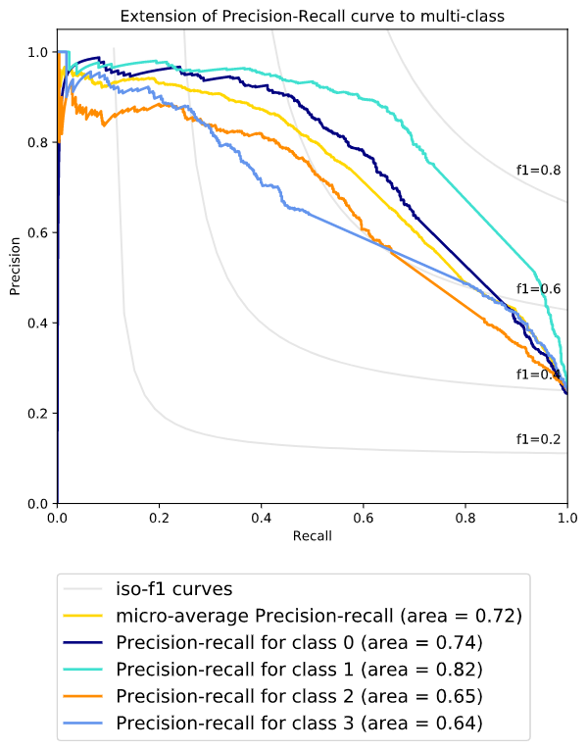
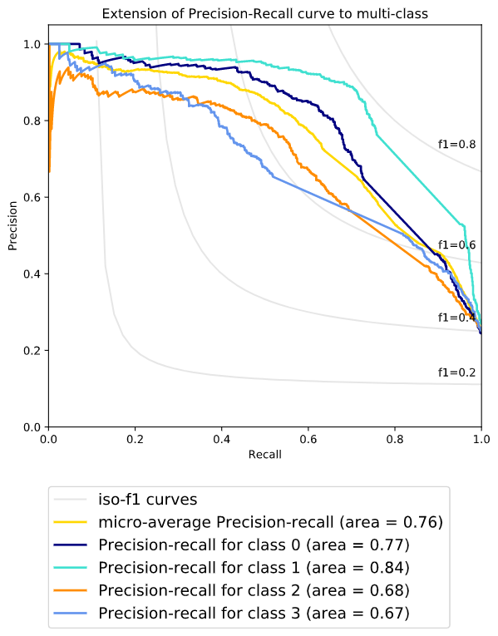
SVM MODEL RESULTS
Precision Recall F1, CV N-grams
Precision Recall F1, TF/IDF N-grams

Slide 32
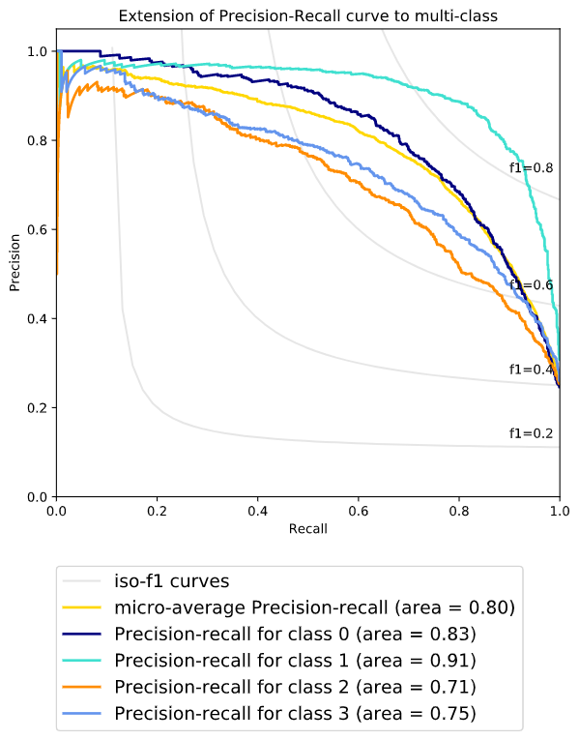
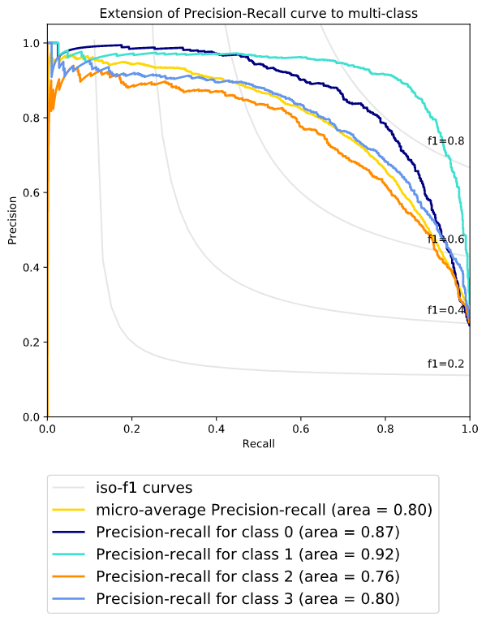
SVM MODEL RESULTS
Precision Recall F1, CV Chars
Precision Recall F1, TF/IDF Chars

Slide 33
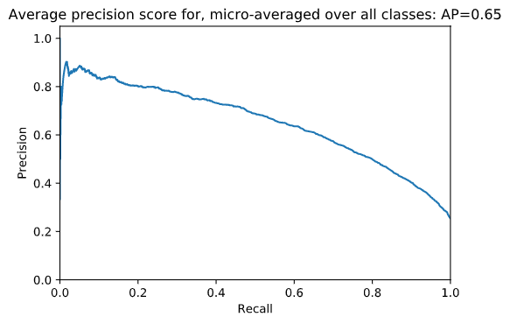
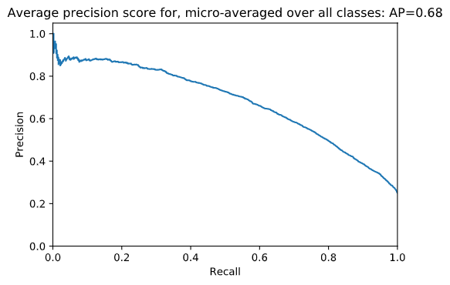
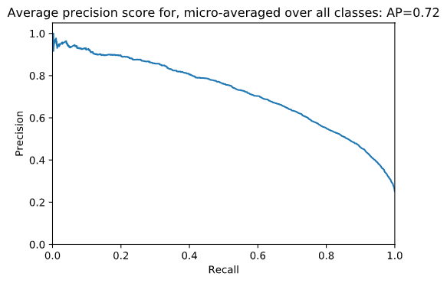
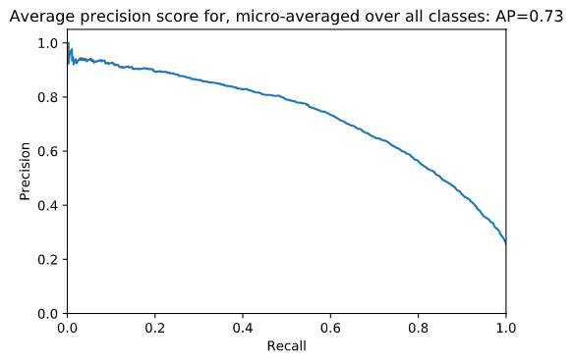
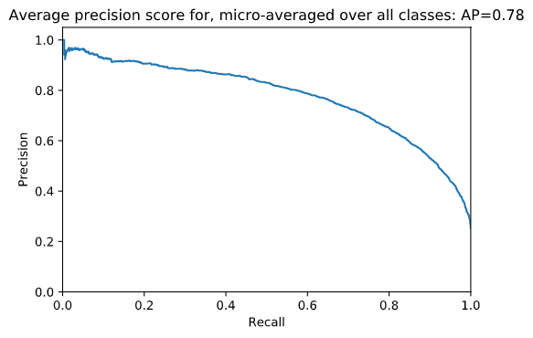
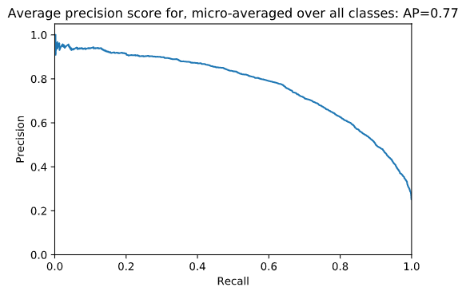
SVM MODEL RESULTS – WORD2VEC FEATURE SIZE COMPARISON
Feature size = 100
Feature size = 500
Feature size = 1000
Feature size = 2000
Feature size = 4000
Feature size = 6000

Slide 34
SVM MODEL RESULTS – WORD2VEC FEATURE SIZE COMPARISON

Slide 35
FEATURE SELECTION
We did feature selection using the package f_class_if from sklearn to select the top 10 percentile from each vectorizer / embedding
selector = SelectPercentile(f_classif, percentile=10)
selector.fit(x_train_cv, train_data_sample.category)
x_train_cv_10p = selector.transform(x_train_cv).toarray()
x_test_cv_10p = selector.transform(x_test_cv).toarray()

Slide 36
FEATURE SELECTION RESULTS COMPARISON
We ran SVM with test & train of both actual and feature selected datasets. Below is a comparison of results between CountVectorizer Bag of Words for actual data vs feature selected data

Slide 37
FEATURE SELECTION RESULTS COMPARISON
Below is a comparison of results between CountVectorizer Bag of N-grams for actual data vs feature selected data

Slide 38
FEATURE SELECTION RESULTS COMPARISON
Below is a comparison of results between CountVectorizer Bag of chars for actual data vs feature selected data

Slide 39
We will continue feature selection with other feature selection methods to better determine the significance of it to our project
We will continue to build other classification models like Logistic Regression, Naïve Bayes & Decision Trees

Slide 40
MODELS
With the previous SVM model as the baseline, the following models were built,
Logistic Regression
Naïve Bayes
Decision Trees
All the models were built using Word2Vec embedding. The embedding was trained using the 120,000 instances, the entire training set

Slide 41
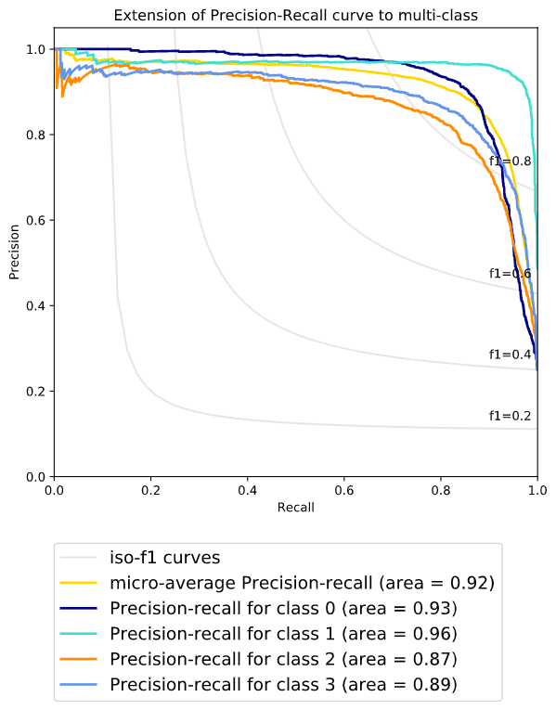

MODELS – PERFORMANCE COMPARISON
Baseline Model – SVM
120,000 instances
Min word count = 5
No.of Dimensions = 300
Logistic Regression
120,000 instances
Min word count = 5
No.of Dimensions = 300

Slide 42
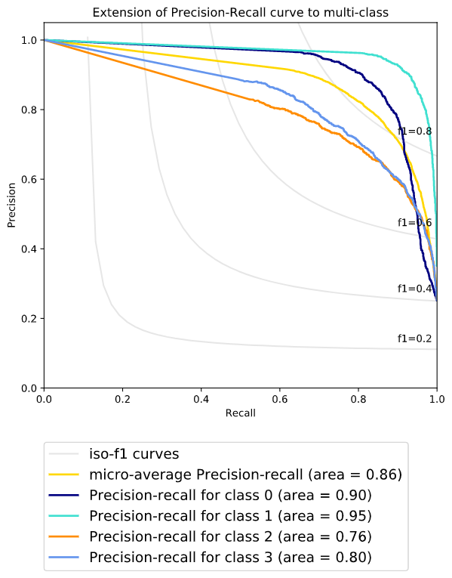
MODELS – PERFORMANCE COMPARISON (Cont’d)
Baseline Model – SVM
120,000 instances
Min word count = 5
No.of Dimensions = 300
Naïve Bayes
120,000 instances
Min word count = 5
No.of Dimensions = 300

Slide 43
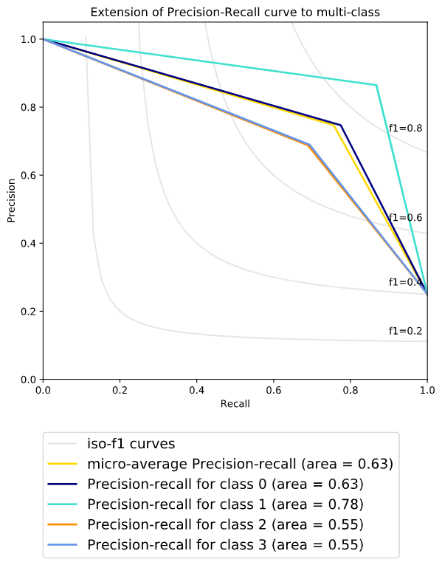
MODELS – PERFORMANCE COMPARISON (Cont’d)
Baseline Model – SVM
120,000 instances
Min word count = 5
No.of Dimensions = 300
Decision Trees
120,000 instances
Min word count = 5
No.of Dimensions = 300

Slide 44
FINAL PROJECT PRESENTATION – 22nd May 2020

Slide 45
CROSS VALIDATION
We ran a 5 fold cross validation on the training dataset and re-ran all the models
The models on the “solo” runs were trained on the 120,000 instance training set and tested on a separate 7600 instance test set
The results of cross validation closely follow the previous “solo” runs
Logistic Regression & SVM compare very closely in terms of the metrics. However, SVM was very resource intensive

Slide 46
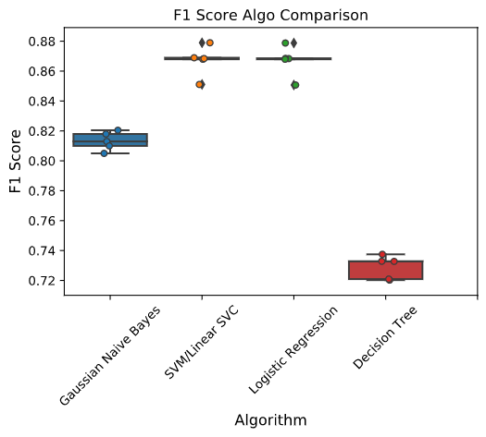
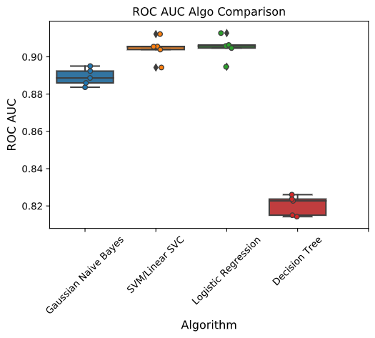
CROSS VALIDATION – COMPARISON OF RESULTS

Slide 47
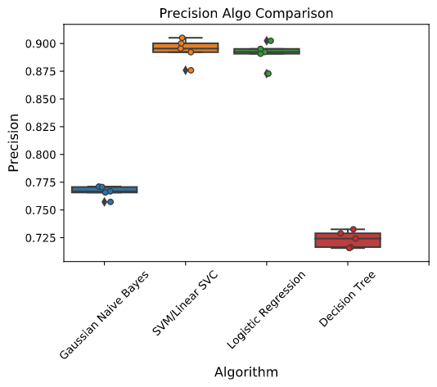
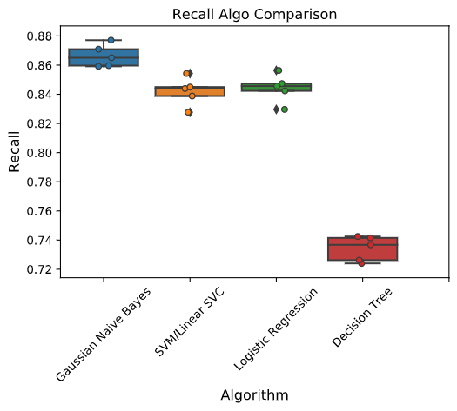
CROSS VALIDATION – COMPARISON OF RESULTS

Slide 48
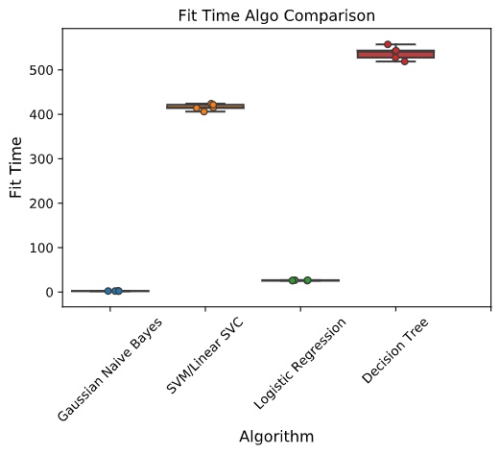
CROSS VALIDATION – COMPARISON OF RESULTS
Based on the previous metrics and comparison, Logistic Regression emerges as the model of choice

Slide 49
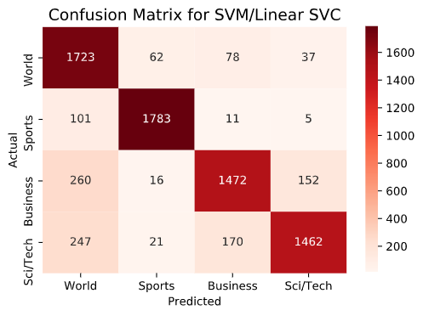
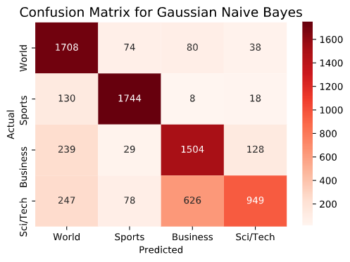

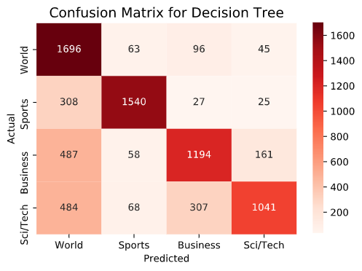
CROSS VALIDATION – COMPARISON OF RESULTS, CONFUSION MATRIX

Slide 50
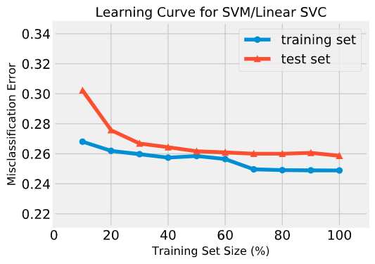
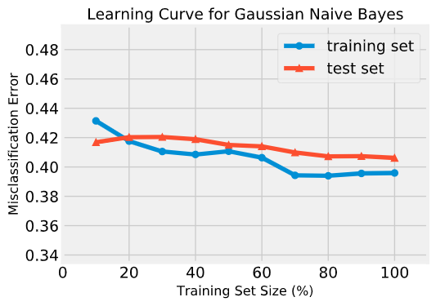
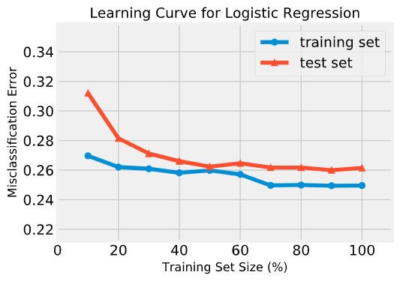
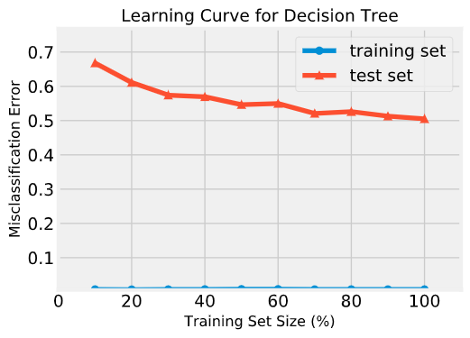
CROSS VALIDATION – COMPARISON OF RESULTS, LEARNING CURVE

Slide 51
ENSEMBLE METHODS
The following ensemble methods were used
Bagging
The base estimator was chosen to be Logistic Regression
Stacking
The initial estimators in stacking were chosen to be Naïve bayes and SVM. The meta learner was Logistic Regression
Boosting
An Adaboost classifier was used for boosting in this iteration.

Slide 52
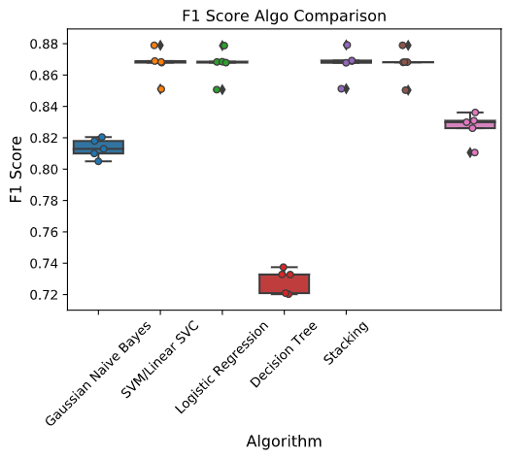
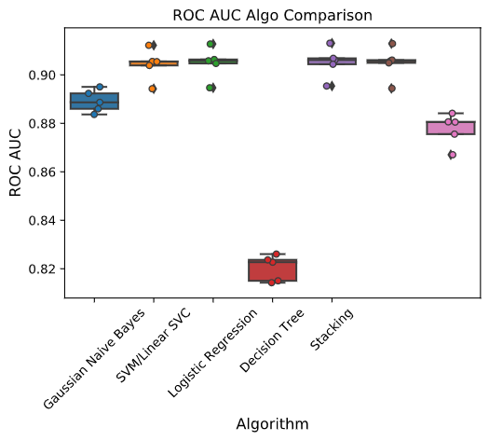
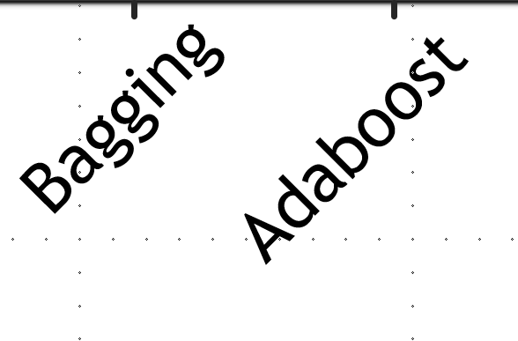
ENSEMBLE METHODS vs OTHERS
Bagging
Adaboost

Slide 53
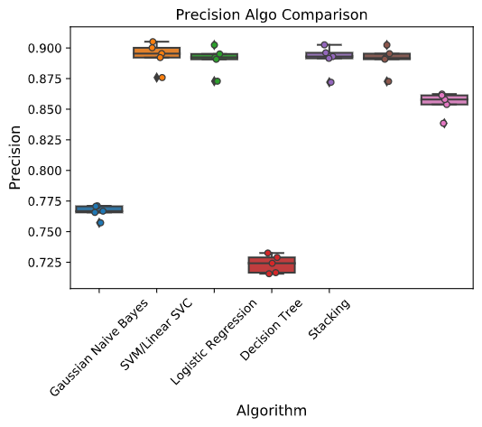
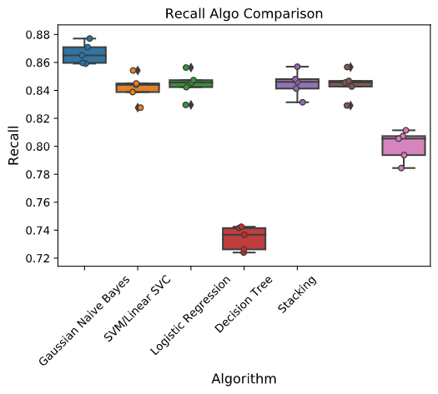
ENSEMBLE METHODS vs OTHERS

Slide 54
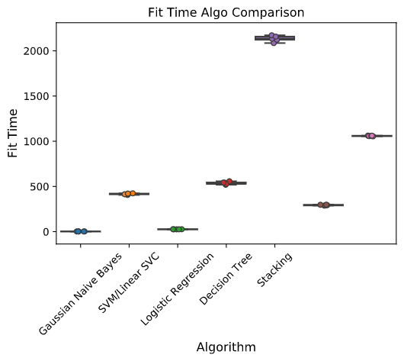
ENSEMBLE METHODS vs OTHERS
Based on the metrics seen so far, it is clear that “Bagging” ensemble method is the algorithm of choice
Stacking and Bagging perform almost similarly in terms of F1 Score, ROC AUC, Precision & Recall
However, in terms of Fit time, stacking took almost 25 minutes to fit, while bagging took just over 3.5 mins

Slide 55

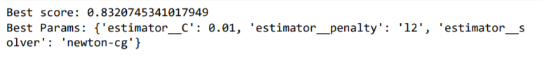


HYPERPARAMETER TUNING
We performed hyperparameter tuning with Grid Search
For Gaussian Naïve Bayes, ‘var_smoothing’ parameter was tuned
For Logistic Regression, ‘penalty’, ‘C’, ‘Solver’ hyperparameters were tuned
For SVM, estimator penalty, tolerance, loss & C parameters were tuned
For Decision trees, ‘splitter’, ‘min_samples_split’ were tuned
Clearly, the best params are pretty much the default ones.
The algorithms are already pretty smart about the defaults or can calculate them. Tuning these hyper-parameters might actually cause overfitting

Slide 56

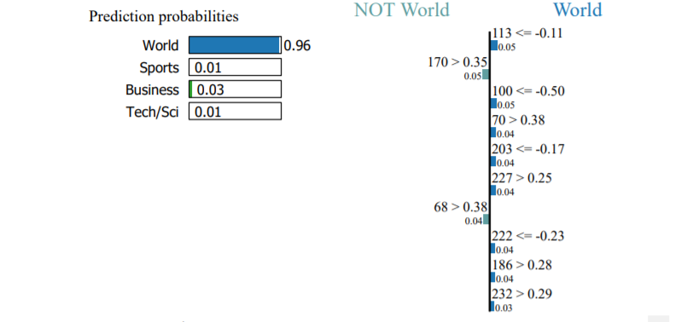
MODEL INTERPRETABILITY - LIME
LIME stands for Locally Interpretable Model Agnostic Explanations
Instantiate Explainer explains a specific instance in the dataset. The 34th document in this example
A “text only” explainer can be visualized as seen below

Slide 57
RESULTS & DISCUSSION
If this is deployed in production, the model of choice is Logistic Regression. SVM, Logistic Regression, Stacking & Bagging are very comparable in terms of F1 Score, ROC AUC, Precision & Recall. However, Logistic Regression is orders of magnitude faster with a very low fit time.
Logistic Regression achieves, f1 Score of 92%
Hyperparameter Tuning – The results of hyperparameter tuning suggest that default parameters are the best and therefore, tuning them further will result in overfitting
Model Interpretability – Advanced word embeddings like Word2Vec inherently make the model “black box”. Though LIME was used, it must be noted that in the “text only” explainer, the features shown are just numbers. They have gone through previous processing and can no longer be traced back to their original form. Simpler vectorization techniques like TF-IDF still retain the original features and can therefore allow LIME to explain them

Slide 58
NEXT STEPS
Use other word embedding techniques like BERT, ElMO
Use more advanced models such as CNN, Deep Learning
Look at ways to deploy the model in a real world business scenario. For eg, a mobile news service that can get news from multiple sources and present them under different classes

Slide 59
REFERENCES
# https://seaborn.pydata.org/introduction.html#intro-plot-customization
# - Dipanjan S's tutorials:
# https://github.com/dipanjanS
# - Analytics Vidhya:
# https://www.analyticsvidhya.com/blog/2018/04/a-comprehensive-guide-to-understand-and-implement-text-classification-in-python/
# - Jason Brownlee's Feature Selection For Machine Learning in Python
# https://machinelearningmastery.com/feature-selection-machine-learning-python/
# - Susan Li's Multi-class text classification with Scikit-learn:
# https://towardsdatascience.com/multi-class-text-classification-with-scikit-learn-12f1e60e0a9f
# - Vadim Smolyakov Ensemble Learning to Improve Machine Learning Results:
# https://blog.statsbot.co/ensemble-learning-d1dcd548e936
# - Udacity course video on Youtube UD120:
# https://www.youtube.com/watch?v=GdsLRKjjKLw
# - Hyperparameter Tuning with Hyperopt
# https://towardsdatascience.com/automated-machine-learning-hyperparameter-tuning-in-python-dfda59b72f8a
# - Hyperparameter Tuning for Gaussian NB
# https://www.quora.com/Can-the-prior-in-a-naive-Bayes-be-considered-a-hyperparameter-and-tuned-for-better-accuracy
# - Hyperparameter Tuning for Decision Trees
# https://towardsdatascience.com/how-to-tune-a-decision-tree-f03721801680
# - Lime tutorial
# https://marcotcr.github.io/lime/tutorials/Lime%20-%20multiclass.html
References - Code sample sources disclaimer:
# Code for this project is either directly from (with some modification),
# or inspired by, but not limited to the following sources:
# - Respective documentation and examples from each used API's doc/guide website
# - Kelly Epley Naive Bayes:
# https://towardsdatascience.com/naive-bayes-document-classification-in-python-e33ff50f937e
# - MLWhiz's excellent blogs about text classification and NLP:
# https://mlwhiz.com/blog/2018/12/17/text_classification/
# https://mlwhiz.com/blog/2019/01/17/deeplearning_nlp_preprocess/
# https://mlwhiz.com/blog/2019/02/08/deeplearning_nlp_conventional_methods/
# https://www.kaggle.com/mlwhiz/conventional-methods-for-quora-classification/
# - Christof Henkel preprocessing:
# https://www.kaggle.com/christofhenkel/how-to-preprocessing-when-using-embeddings
# - datanizing GmbH:
# https://medium.com/@datanizing/modern-text-mining-with-python-part-1-of-5-introduction-cleaning-and-linguistics-647f9ec85b6a
# - Datacamp wordcloud:
# https://www.datacamp.com/community/tutorials/wordcloud-python
# - Seaborn Pydata tutorials:

